Slide 1

Department of Computer Science and Engineering
M. S. Ramaiah Institute of Technology
(Autonomous Institute, Affiliated to VTU)
Data Structures CS 32
Vandana S Sardar
Mamatha Jadhav V
Notes:
‹#›

Slide 2
Syllabus
Unit I
Basic Concepts: Pointers and Dynamic Memory Allocation, Algorithm Specification, Data Abstraction. Arrays and Structures: Arrays, Dynamically Allocated Arrays, Structures and Unions, Polynomials, Sparse Matrices, Representation of Multidimensional Arrays, Strings.
Unit II
Stacks and Queues: Stacks, Stacks Using Dynamic Arrays, Queues, Circular Queues Using Dynamic Arrays, Evaluation of Expressions, Multiple Stacks and Queues.

Slide 3
Syllabus
Unit III
Linked Lists: Singly Linked lists and Chains, Representing Chains in C, Linked Stacks and Queues, Polynomials, Additional List operations, Sparse Matrices, Doubly Linked Lists.
Unit IV
Trees: Introduction, Binary Trees, Binary Tree Traversals, Additional Binary Tree Operations, Threaded Binary Trees, Heaps, Binary Search Trees, Selection Trees, Forests, Representation of Disjoint Sets, Counting Binary Trees.

Slide 4
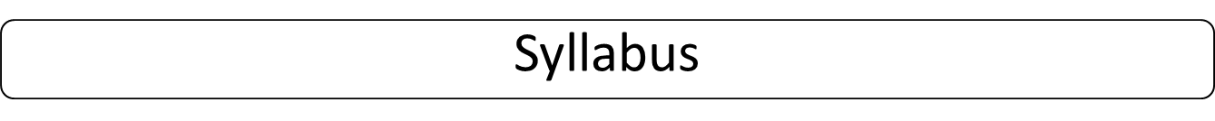
Unit V
Graphs: The Graph Abstract Data Type, Elementary Graph Operations. Priority Queues: Single- and Double-Ended Priority Queues, Leftist Trees. Efficient Binary Search Trees: AVL Trees.
Text Book:
1. Horowitz, Sahni, Anderson-Freed: Fundamentals of Data Structures in C, 2nd Edition, Universities Press, 2008.

Slide 5
Revision of C Concepts: E Balagurusamy
Introduction to C
Data Types
C Constants
Operators
Control Structures
Loops

Slide 6
Revision of C Concepts: E Balagurusamy
Arrays
Strings
Functions
Structures
Pointers

Slide 7
Introduction to C
C is a programming language developed at AT & T’s Bell Laboratories of USA in 1972.
C compiler is written in C.
Major parts of popular operating systems like Windows, UNIX, Linux is still written in C.

Slide 8
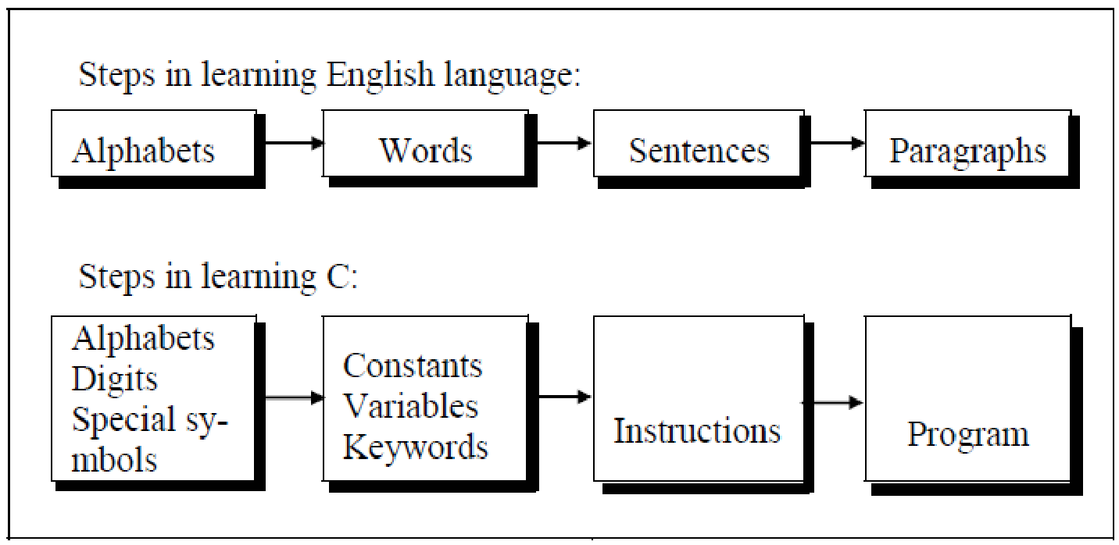
Introduction to C

Slide 9
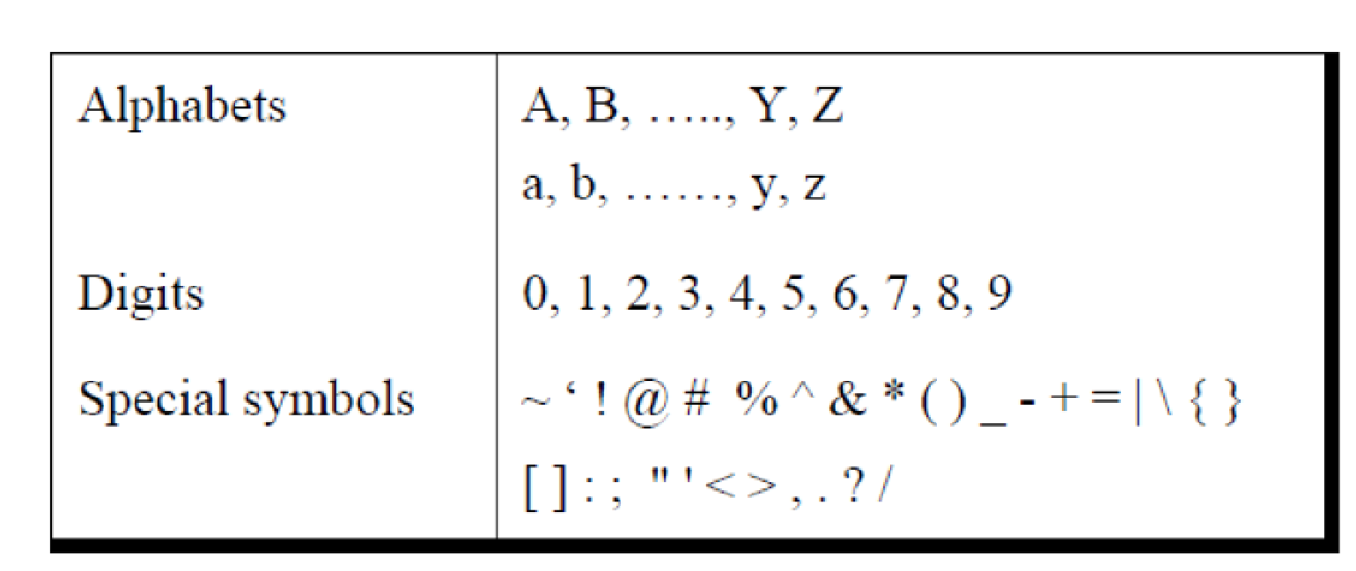
Introduction to C
Character Set

Slide 10
Introduction to C
Identifiers: User defined word used to name of entities like variables, arrays, functions, structures.
Keywords: Reserved words
Examples: int, short, signed, unsigned, default, volatile, float, long, double, break, continue, typedef, static, do, for, union, return, while, do, extern, register, enum, case, goto, struct, char, auto, const etc.

Slide 11
Data Types
Basic built-in data types: int, float, double, char
Enumeration data type: enum
Derived data type: pointer, array, structure, union
Void data type: void

Slide 12
Data Types
There are two types of type qualifier in C:
Size qualifier: short, long
Sign qualifier: signed, unsigned

Slide 13
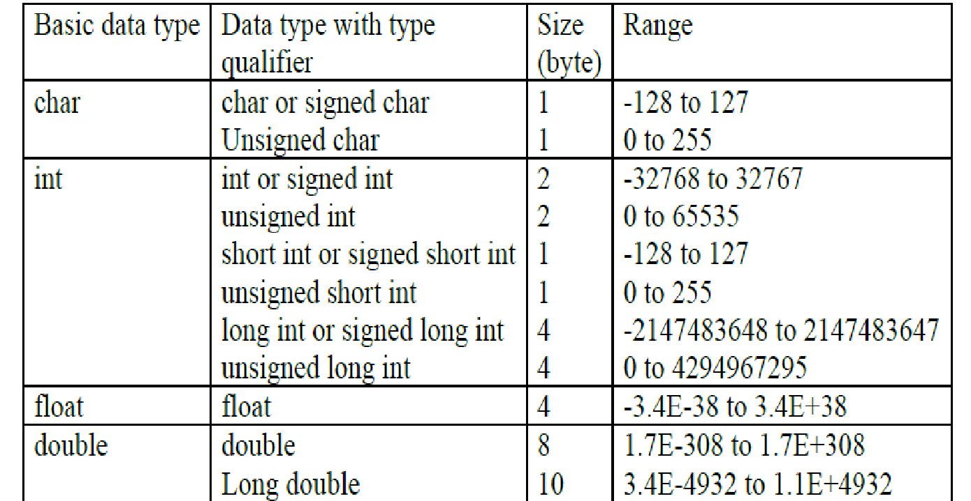
Data Types

Slide 14
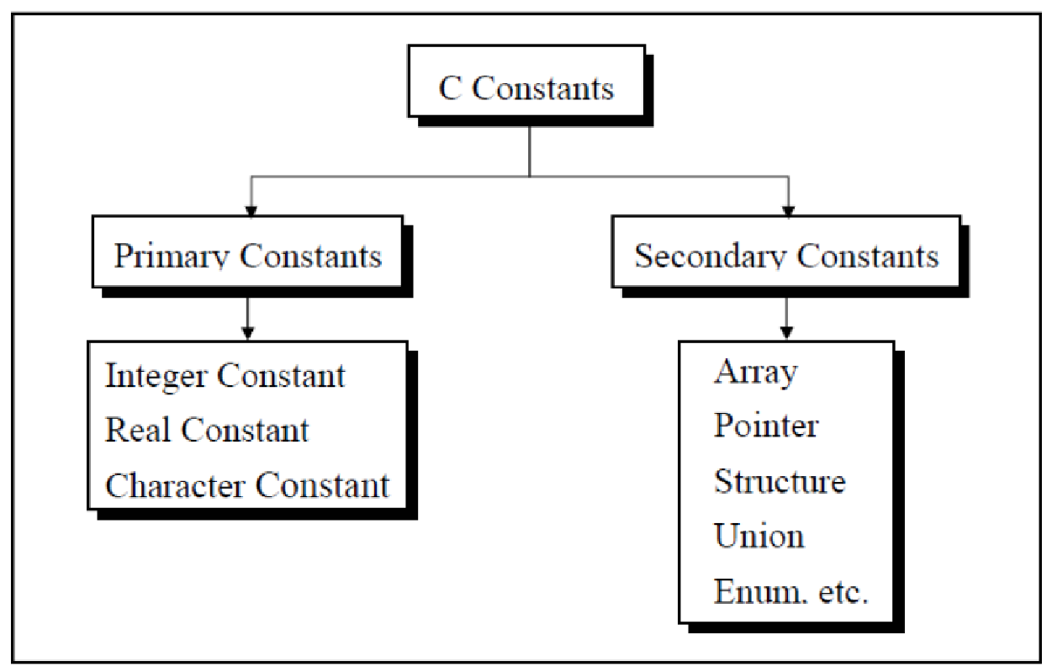
C Constants

Slide 15
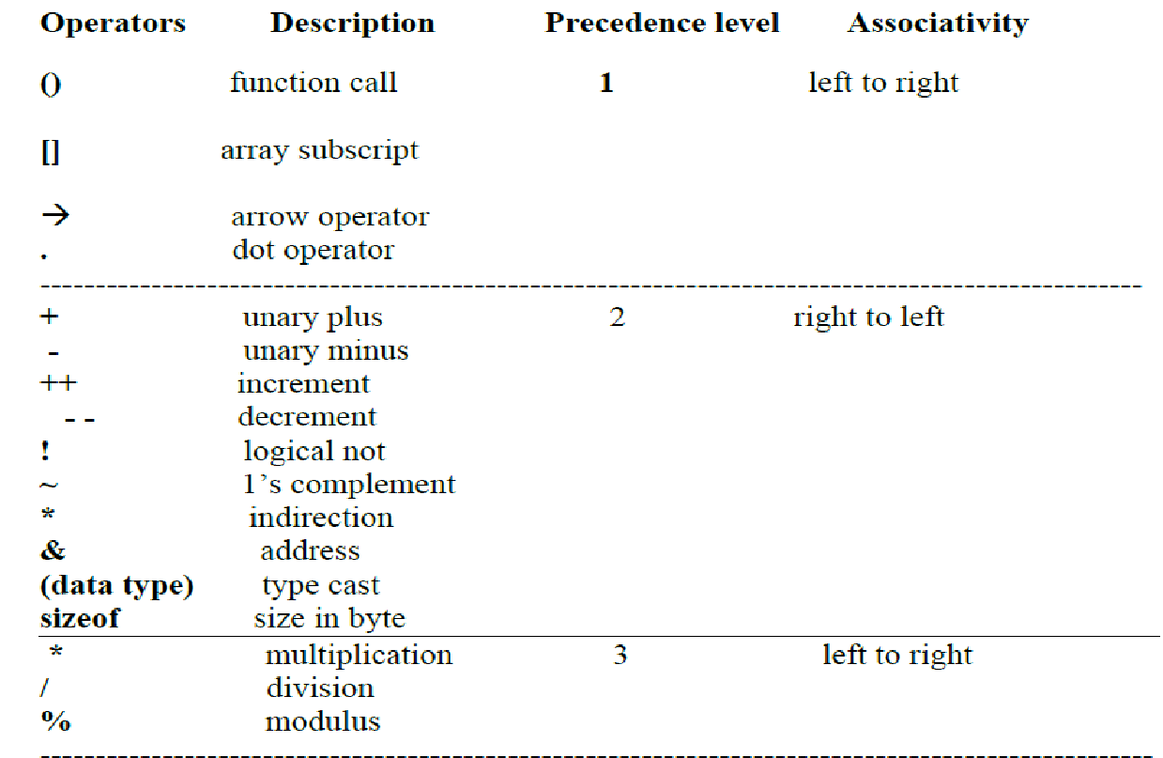
Operators

Slide 16
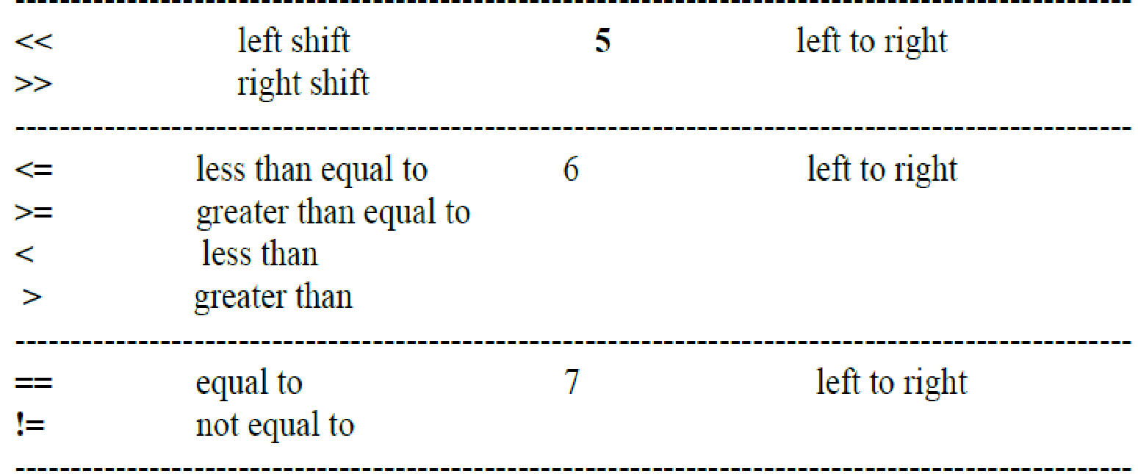
Operators
Notes:
‹#›

Slide 17
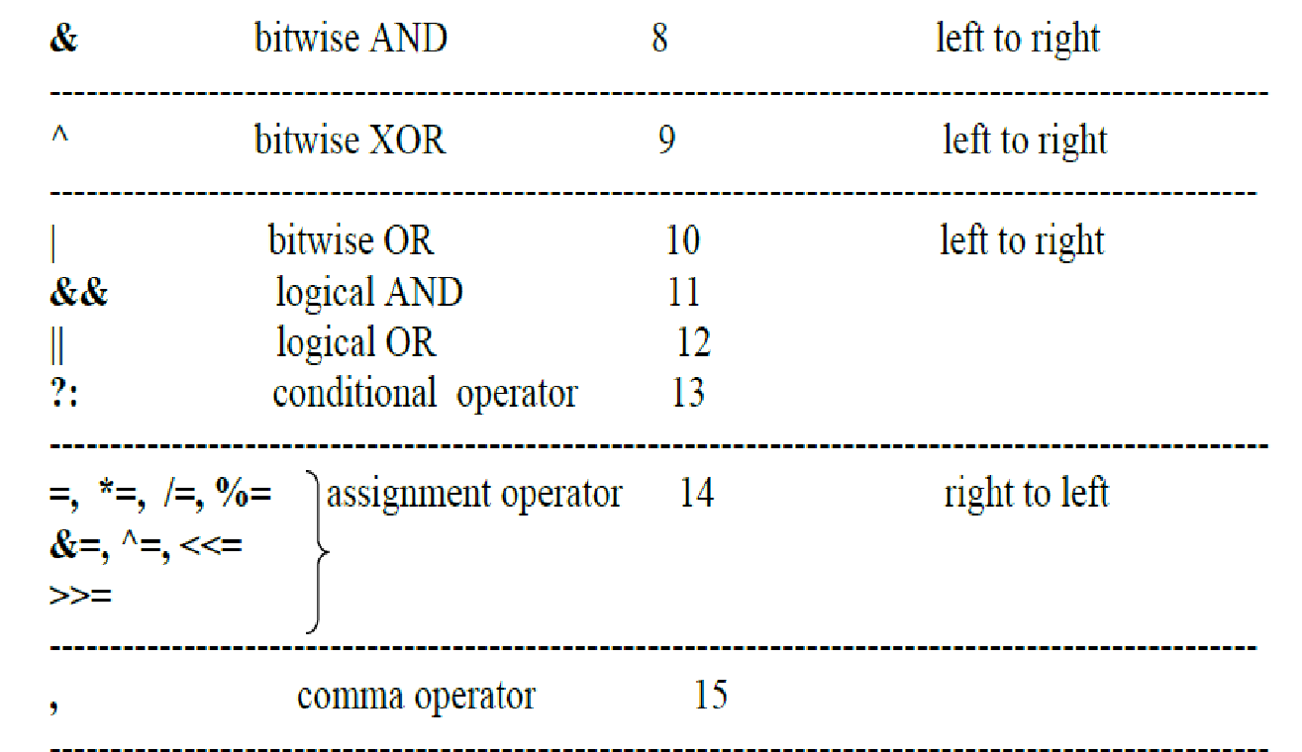
Operators

Slide 18
Control Structures
Simple if statement
if..else statement
Nested if else statement
else if ladder
switch statement

Slide 19
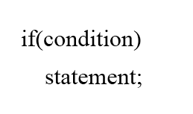
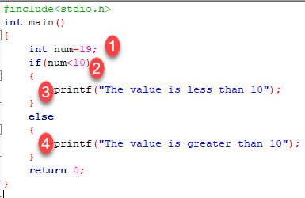
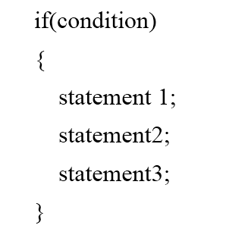
Control Structures : Simple if and if else

Slide 20
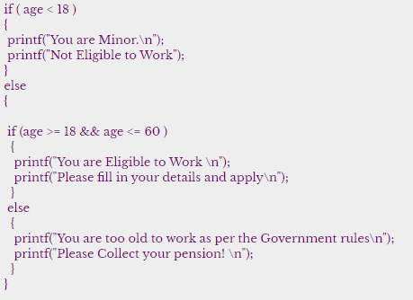
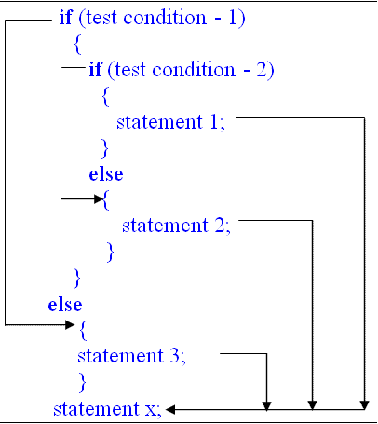
Control Structures: Nested if else

Slide 21
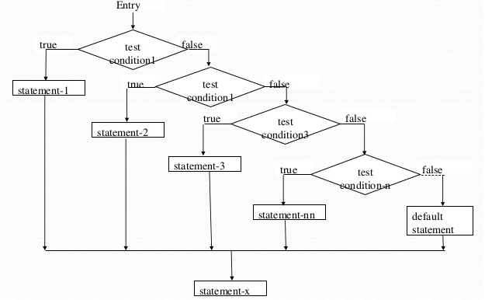
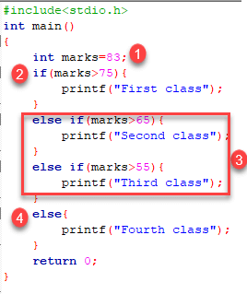
Control Structures: else if ladder

Slide 22
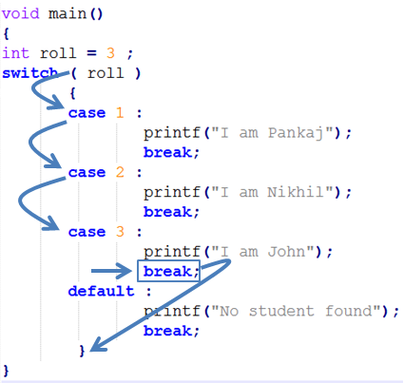
Control Structures
Switch statement

Slide 23
Loops
while loop
do while loop
for loop

Slide 24
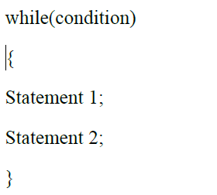
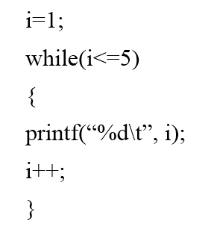
Loops
while loop

Slide 25
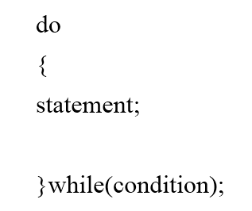
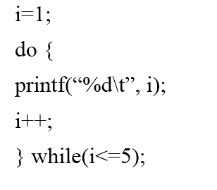
Loops
do-while loop

Slide 26
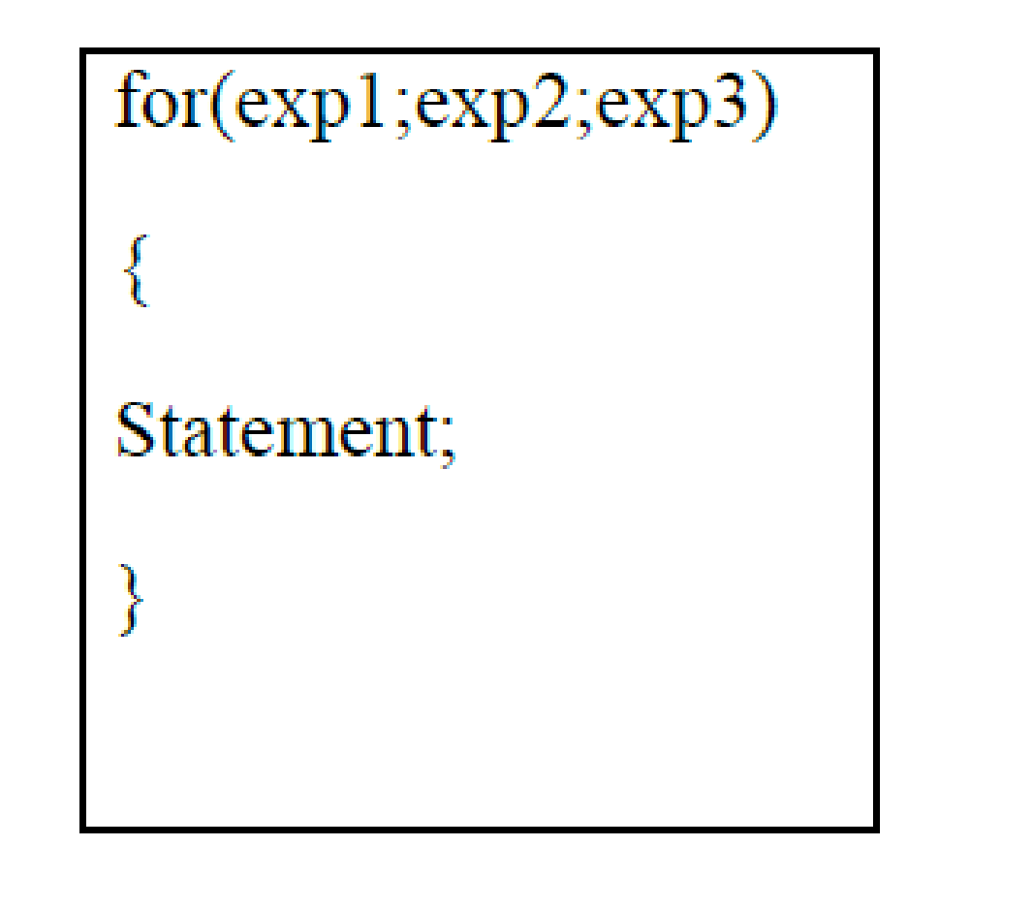
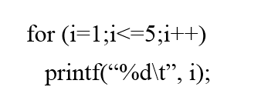
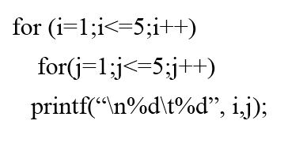
Loops
for loop

Slide 27
Example: C Programs
Write a C program to check whether number is even or odd.
Write a C program to print the grade obtained by a student using else if ladder/switch case.
Write a C program to find the factorial of a number.
Write a C program to print the table of a number.

Slide 28
Arrays
Array is the collection of similar data types or collection of similar entity stored in contiguous memory location.
Array of characters is a string.
Each data item of an array is called an element and located in separated memory location.
Each of elements of an array share a variable but each element having different index no. known as subscript.

Slide 29
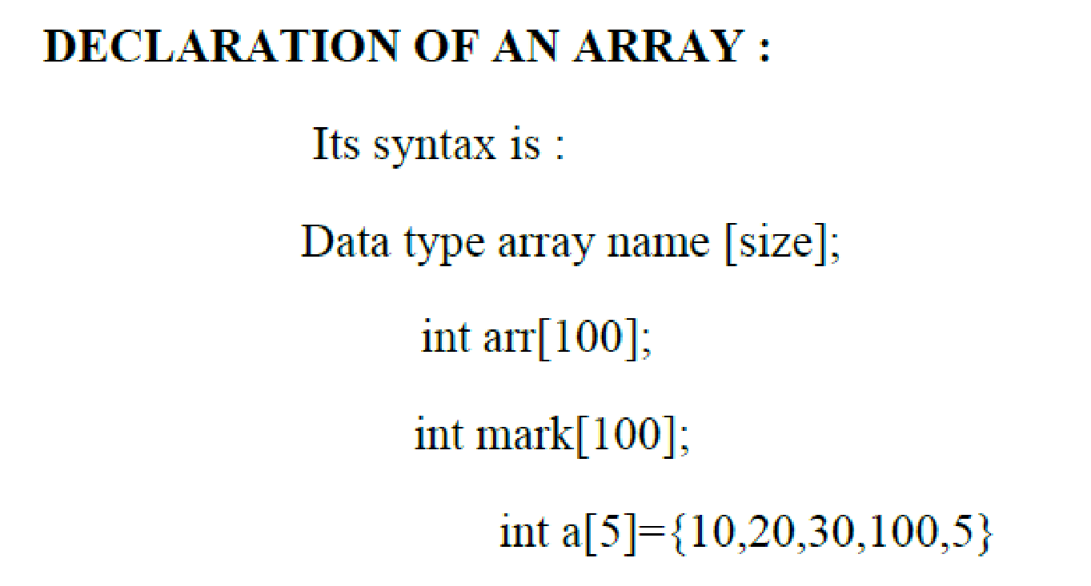
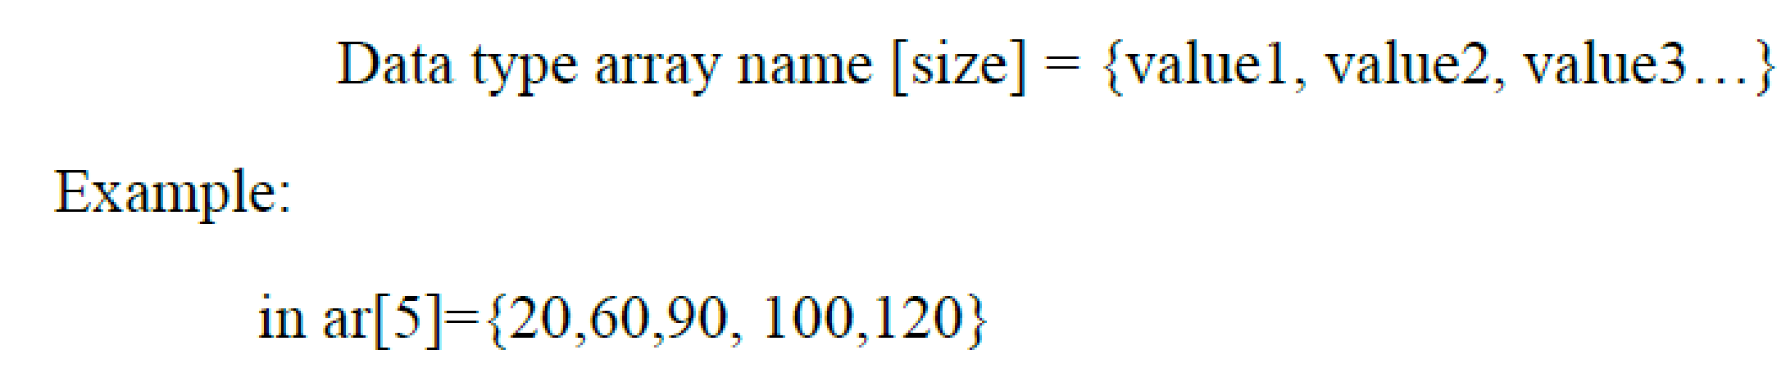
Arrays: Declaration and Initialization

Slide 30
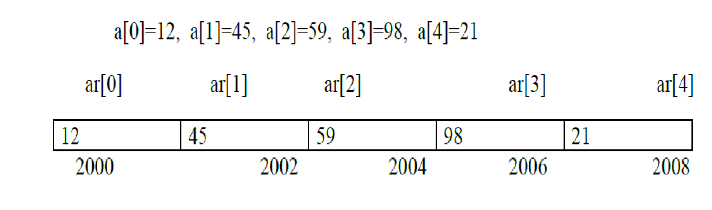
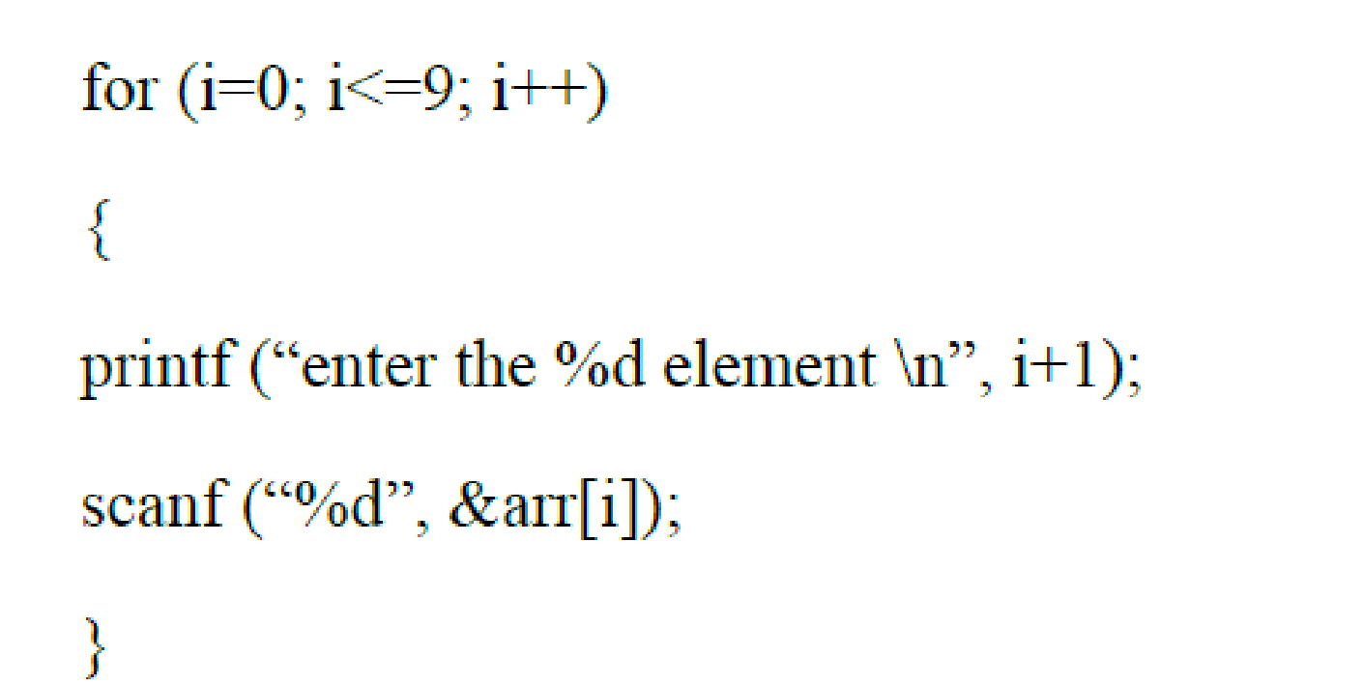
Arrays: Memory Layout and storing elements

Slide 31
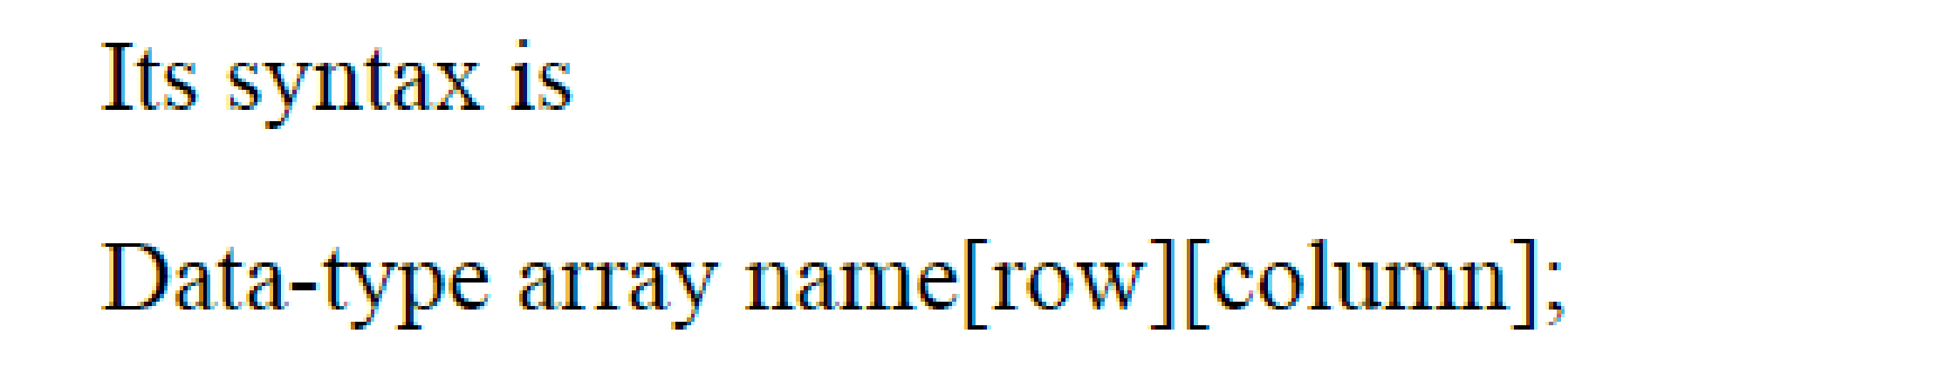
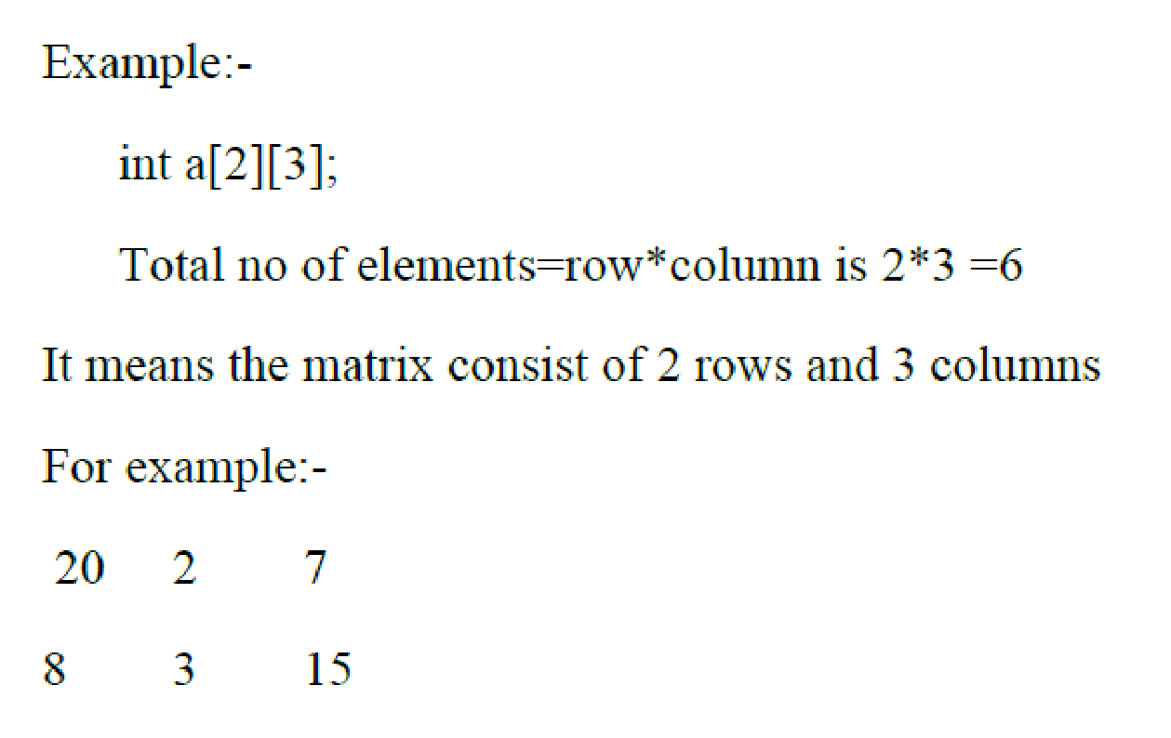
Arrays: 2D, Matrix
Two Dimensional arrays: Known as matrix.

Slide 32
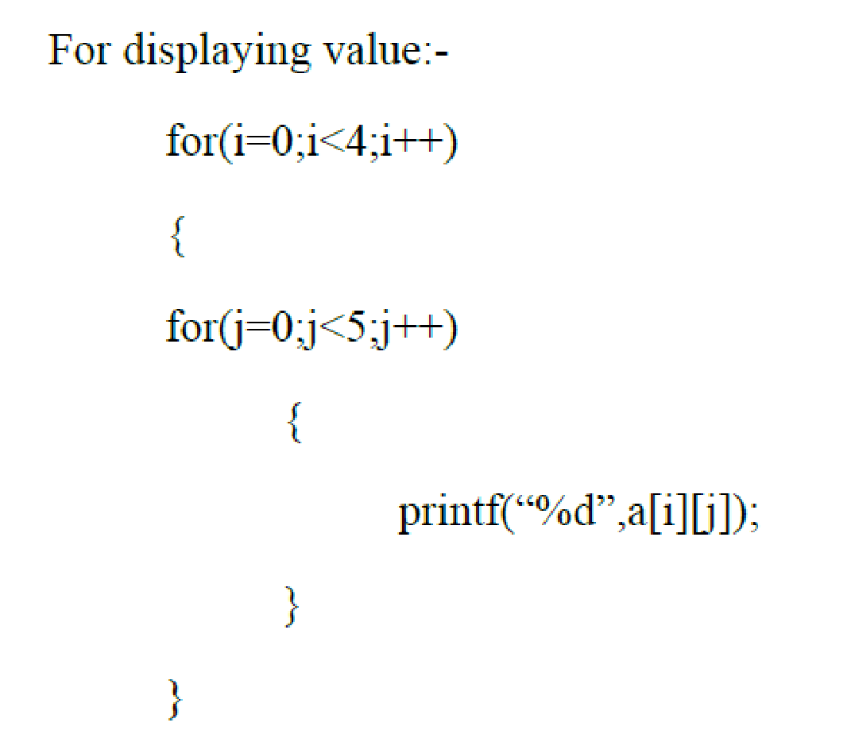
Arrays: 2D Example: Display a matrix

Slide 33
Strings
A string is a simple array with char as a data type.
String is terminated with a special character ‘\0’.
The general syntax for declaring a variable as a string is as follows,
char string_variable_name [array_size];
char first_name[15]; //declaration of a string variable
char last_name[15];
The C compiler automatically adds a NULL character '\0' to the character array created.

Slide 34
Strings: Initialization
char first_name[15] = “RAMESH";
char first_name[15] = {‘R',‘A',‘M',‘E',‘S',‘H','\0'};
// NULL character '\0' is required at end in this declaration

Slide 35
Strings: Read a string
char name[10];
printf("Enter your first name : \n");
scanf("%s", name);
char name[10];
printf("Enter your name: \n");
gets(name);

Slide 36
Strings: Write a string
printf("%s", name);
char name[15];
gets(name); //reads a string
puts(name); //displays a string

Slide 37
Strings: String Handling Functions
Sr.No. | Function & Purpose
1 | strcpy(s1, s2); Copies string s2 into string s1.
2 | strcat(s1, s2); Concatenates string s2 onto the end of string s1.
3 | strlen(s1); Returns the length of string s1.
4 | strcmp(s1, s2); Returns 0 if s1 and s2 are the same; less than 0 if s1<s2; greater than 0 if s1>s2.
5 | strchr(s1, ch); Returns a pointer to the first occurrence of character ch in string s1.
6 | strstr(s1, s2); Returns a pointer to the first occurrence of string s2 in string s1.

Slide 38
Strings: strlen() and sizeof()
char str[] = "MSRIT";
printf("Length of String is %d\n", strlen(str));
// Length of String is 5
printf("Size of String is %d\n", sizeof(str));
// Length of String is 6

Slide 39
Strings: String handling functions: A Program
#include <stdio.h>
#include <string.h>
int main ()
{
char str1[12] = "Hello";
char str2[12] = "World";
char str3[12];
int len ;
/* copy str1 into str3 */
strcpy(str3, str1);
printf("strcpy( str3, str1) : %s\n", str3 );
/* concatenates str1 and str2 */
strcat( str1, str2);
printf("strcat( str1, str2): %s\n", str1 );
/* total length of str1 after concatenation */
len = strlen(str1);
printf("strlen(str1) : %d\n", len );
return 0;
}

Slide 40
Strings: Other functions
strncmp(str1, str2, n) : it returns 0 if the first n characters of str1 is equal to the first n characters of str2, less than 0 if str1 < str2, and greater than 0 if str1 > str2.
strncpy(str1, str2, n) : This function is used to copy a string from another string. Copies the first n characters of str2 to str1
strstr(str1, str2): it returns a pointer to the first occurrence of str2 in str1, or NULL if str2 not found.
strncat(str1, str2, n) : Appends (concatenates) first n characters of str2 to the end of str1 and returns a pointer to str1.

Slide 41
Functions
A function is a block of code that performs a specific task.
C allows you to define functions according to your need, These functions are known as user-defined functions.
C functions can be classified into two categories
Library functions
User-defined functions

Slide 42
Functions: Benefits
It provides modularity to your program's structure.
In case of large programs with thousands of code lines, debugging and editing becomes easier.
It makes the program more readable and easy to understand.
It is used to avoid rewriting same logic/code again and again in a program.
Notes:
‹#›

Slide 43
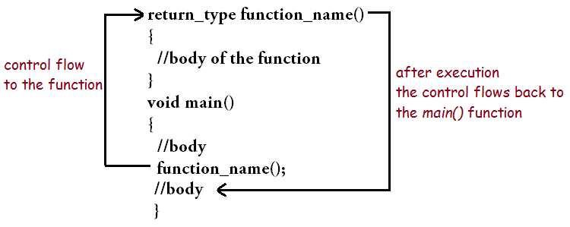
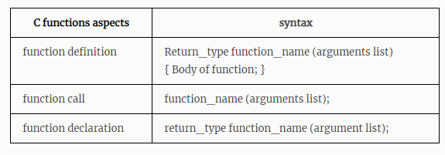
Functions: Syntax

Slide 44
Functions: Parameters /Arguments
Formal Parameter: The parameter which is written at the function definition is known as a formal parameter.
Actual Parameter: The parameter that is written at the function call is known as the actual parameter.
int sum(int,int); Function Declaration/ Function Prototype
void main()
{ int a=10 ,b=20 ;
sum(a ,b );//actual parameter Calling Function (Function Call)
}
int sum(int x, int y)//formal parameter Called Function (Function Definition )
{
//body of the function
}

Slide 45
Functions: Categories
Function with arguments and a return value
Function with arguments and no return value
Function with no arguments and no return value
Function with no arguments and a return value

Slide 46
Functions: Category 1
With arguments and with return values | function declaration: int function ( int ); function call: z=function ( a ); Function with argument function definition: int function( int a ) { statements; return a; Function with return value }

Slide 47
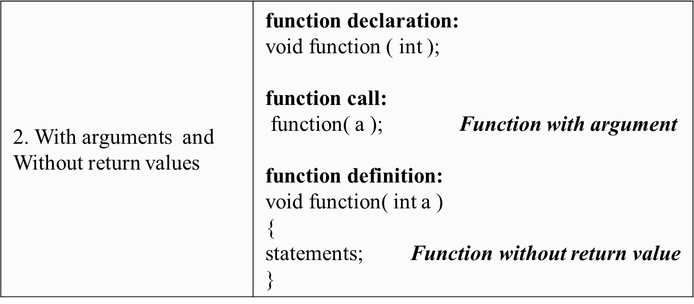
Functions: Category 2

Slide 48
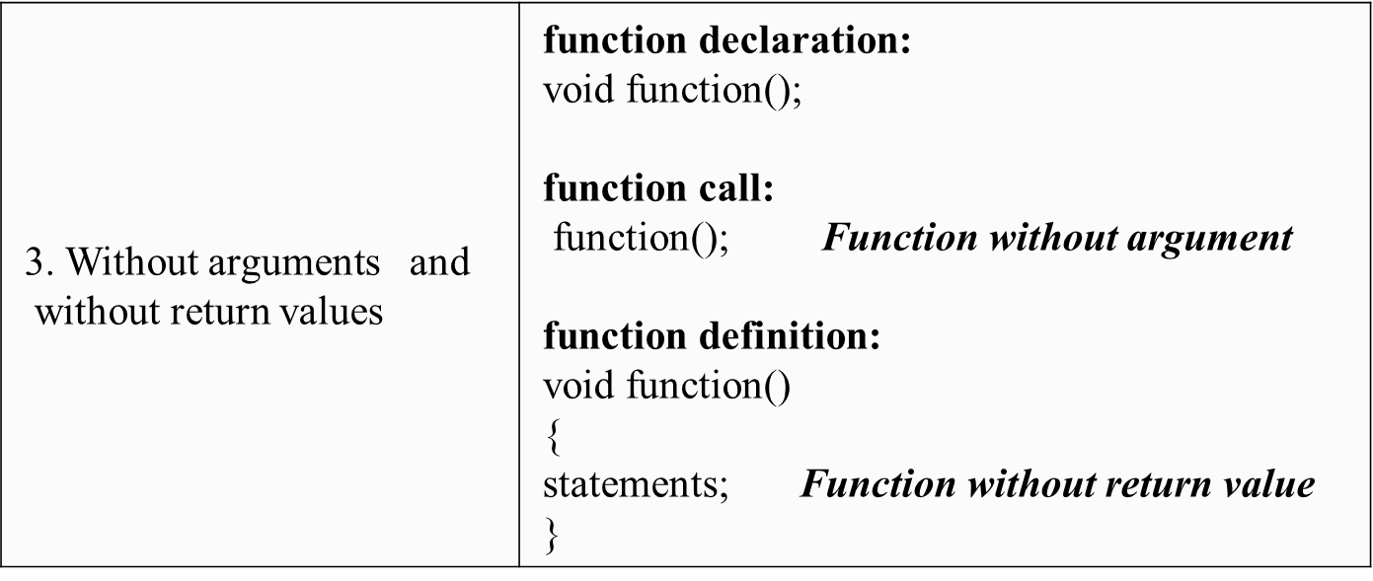
Functions: Category 3

Slide 49
Functions: Category 4
4. Without arguments and With return values | function declaration: int function ( ); function call: z= function ( ); Function without argument function definition: int function( ) { statements; return a; Function with return value }

Slide 50
Structures
Structure is a user-defined data type in C programming language ,that combines logically related data items of different data types together.
struct keyword is used to declare the structure in C.
Variables inside the structure are called members of the structure.

Slide 51
Structures: Syntax and Example
Syntax Example
struct struct_name
{
DataType member1_name; DataType member2_name; DataType member3_name;
…
};
struct employee
{
char name[50];
int age;
float salary;
};

Slide 52
Structures: Examples
struct student
{
char name[60];
int roll_no;
float marks;
} s1,s2,s3….sn;
Name of the structure
members of the structure
Declaring Structure variables
s1,s2,s3….sn
at the time of definition
struct student
{
char name[60];
int roll_no;
float marks;
};
void main()
{
struct student s1,s2,s3........sn; // Declaring Structure variables
within a main function.
}

Slide 53
Structures: Accessing Structure Members
Using Dot(.) operator
Example 2:
#include<stdio.h>
struct Point
{
int x, y;
};
int main()
{
struct Point p1 = {0, 1};
// Accessing members of point p1
p1.x = 20;
printf ("x = %d, y = %d", p1.x, p1.y);
return 0;
}
Example1 :
#include <stdio.h>
struct student
{
char name[60];
int roll_no;
float marks;
} s1;
/*Assigning the values to struct member here*/
s1. roll_no = 101;
s1. marks = 25.0

Slide 54
Structures: Examples
#include <stdio.h>
struct tudent
{ char name[60];
int roll_no;
float marks;
} s3={ “pavan”, 103, 25};
int main()
{
struct student s1 = { “ramesh”, 101, 23 };
struct student s2 = { “suresh”, 102, 27 };
printf ("x = %s, y = %d, z = %f\n", s1.name, s1.roll_no, s1.marks);
printf ("x = %s, y = %d, z = %f\n", s2.name, s2.roll_no, s2.marks);
}
}
Structure member (S3) initialization
Structure member (S1 and S2)
initialization

Slide 55
Structures: Arrays of Structures
/* Array of Structures in C Initialization */
struct Emp
{
int age;
char name[10];
int salary;
} Employees[4] = { {25, "Suresh", 25000}, {24, "Tutorial", 28000}, {22, "Gateway", 35000}, {27, "Mike", 20000} };
Employees[0] ={25, "Suresh", 25000}; Employees[1] = {24, "Tutorial", 28000}; Employees[2] = {22, "Gateway", 35000}; Employees[3] = {27, "Mike", 20000};

Slide 56
Structures: Arrays of Structures
void main()
{
struct student S[4];
S[4] = { {25, "Suresh", 25},
{24, “Ramesh", 28},
{22, “Anoop", 35},
{27, “Arun", 20}
};
}
Structure Definition
Arrays of Structures
struct student
{
int age;
char name[10];
int marks;
};
Initialization members

Slide 57
Examples: C Programs
Write a C program to find the sum of array elements.
Write a C program to implement a linear search technique.
Write a C program to find the transpose of the matrix.
Writ a C program to copy one string into another without using built in functions.
Write a C program to check whether number is palindrome or not using a function with argument and with return value.
Write a C program to add to complex numbers using structures.

Slide 58
Pointers
Pointers is a variable ,which stores the address of another variable.
The purpose of pointer is to save memory space and achieve faster execution time.
& symbol is used to get the address of the variable.
* symbol is used to get the value of the variable that the pointer is pointing to.
variable | Address | value
q | 783592244 | 50
*ptr | 1755463112 | 783592244
Normal Variable
Pointer Variable
Normal variable stores the value ,whereas pointer variable stores the address of the variable.

Slide 59
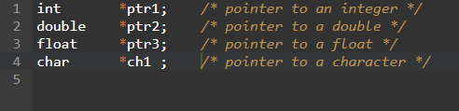
Pointers: Declaring a Pointer
A pointer declaration has the following form.
data_type * pointer_variable_name;
data_type is the pointer's base type of C's variable types and indicates the type of the variable that the pointer points to.
The asterisk (*: the same asterisk used for multiplication) which is indirection operator, declares a pointer.

Slide 60
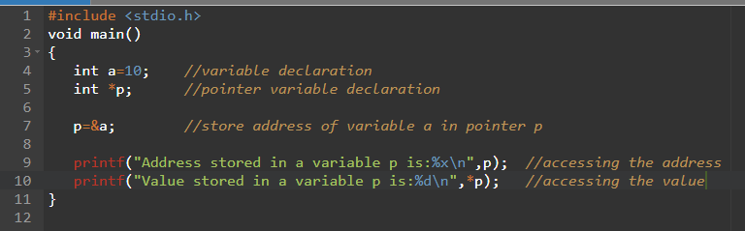
Pointers: Initializing a Pointer
To get the address of a variable, we use the ampersand (&)operator, placed before the name of a variable whose address we need. Pointer initialization is done with the following syntax.
pointer = &variable;

Slide 61
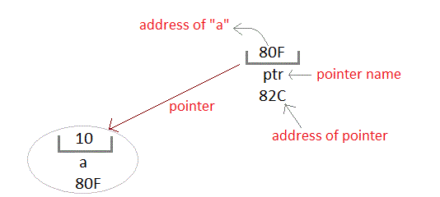
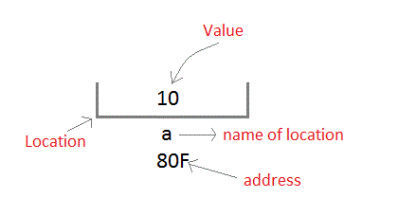
Pointers: Accessing the Address of a Variable
Whenever a variable is defined in C language, a memory location is assigned for it, in which it's value will be stored.
We can easily check this memory address, using the & symbol.
Assume memory location 80F for a variable a.
We can access the value 10 either by using the variable name a or by using its address 80F.
int a = 10;
A pointer variable is therefore nothing but a variable which holds an address of some other variable. And the value of a pointer variable gets stored in another memory location.

Slide 62
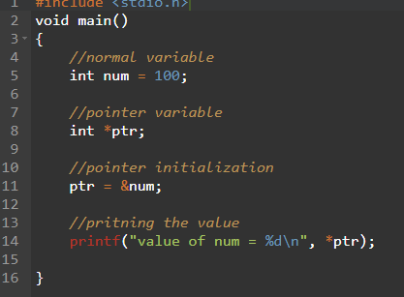
Pointers: Accessing a variable through its pointer
STEPS:
Declare a normal variable, assign the value
Declare a pointer variable with the same type as the normal variable
Initialize the pointer variable with the address of normal variable
Access the value of the variable by using asterisk (*) - it is known as dereference operator

Slide 63
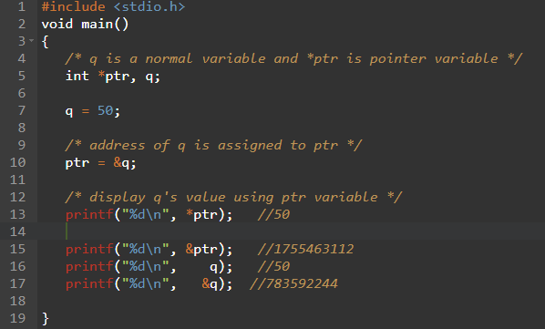
Pointers

Slide 64
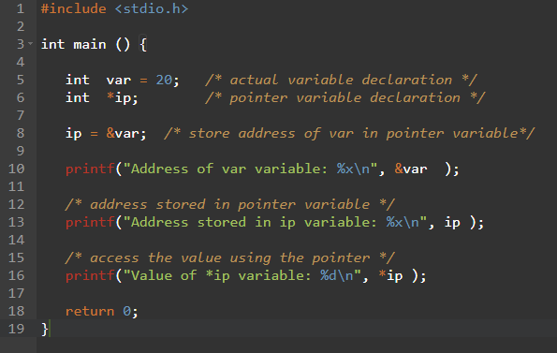
Pointers

Slide 65
Pointers: Benefits(use) of pointers in C
Pointers provide direct access to memory
Pointers provide a way to return more than one value to the functions
Reduces the storage space and complexity of the program
Reduces the execution time of the program
Pointers allows us to perform dynamic memory allocation and deallocation.
Pointers helps us to build complex data structures like linked list, stack, queues, trees, graphs etc.
Pointers allows us to resize the dynamically allocated memory block.

Slide 66
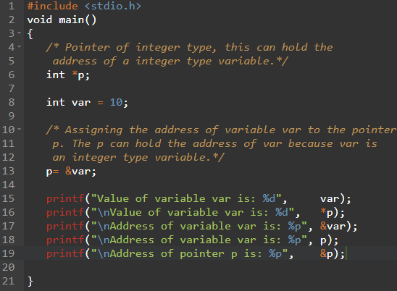
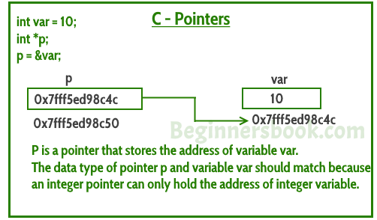
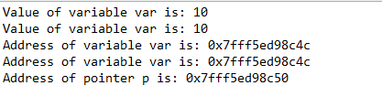
Pointers

Slide 67
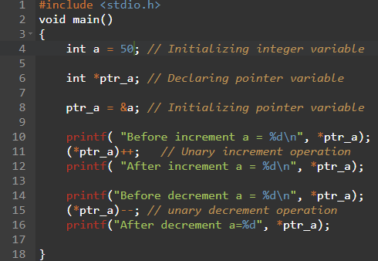

Pointers
A limited set of arithmetic operations can be performed on pointers. A pointer may be:
Incremented ( ++ )
Decremented ( — )
An integer may be added to a pointer ( + or += )
an integer may be subtracted from a pointer
( – or -= )

Slide 68
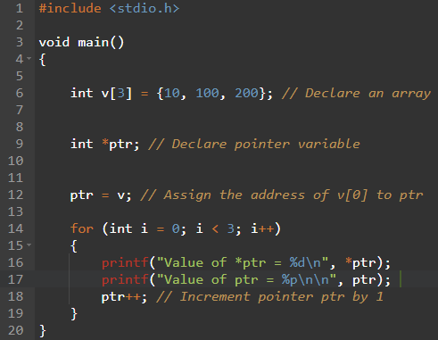
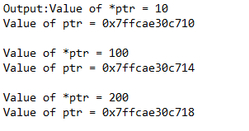
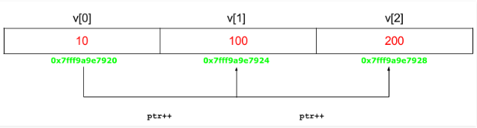
Pointers

Slide 69
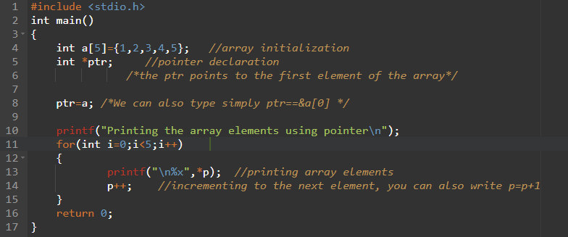
Pointers and Arrays

Slide 70
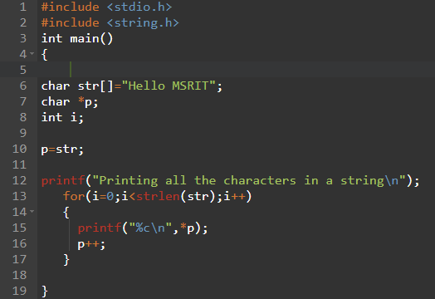
Pointers and Strings

Slide 71

C-program using pointers to determine the length of a character String.

Slide 72

Pointers: Call by reference

